Slide 1
OERs and MERLOT: An International Perspective
Dr, Lesley Farmer
CSU Long Beach

Slide 2
Agenda
Introduction to OERs
Introduction to MERLOT
Integrating OERs

Slide 3
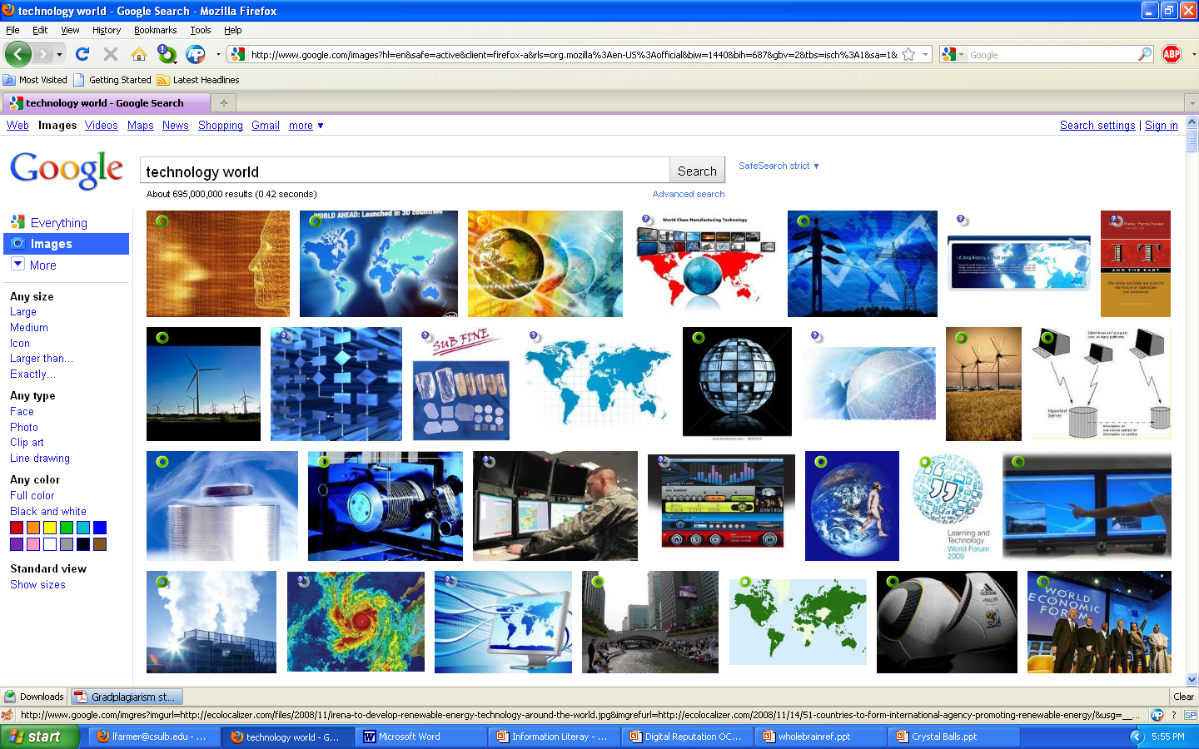

Slide 4
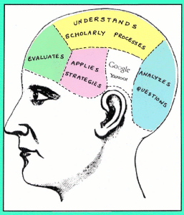
Today’s Literacies
Information Literacy
Technology Literacy
Data Literacy
Visual Literacy
Media Literacy
Global Literacy
Literacy with Responsibility

Slide 5
Science for All Americans
Nature of science: scientific methods and world view
Nature of mathematics
Nature of technology
Physical setting
Living environment
Human organism
Human society
Designed world
Mathematical world
Historical perspectives
Common themes: e.g., systems and models
Habits of mind

Slide 6
What are Open Educational Resources: OERs?
Educational materials and resources offered freely and openly for anyone to use and under some licenses to remix, improve and redistribute.”

Slide 7
Why Use OERs?
Cost savings for students
Facilitates choice of resources
Digital access often
May be more timely
Remix options
Options for student interaction and contribution to publishing
Philosophy of open education
BUT how do you find them and select them??

Slide 9
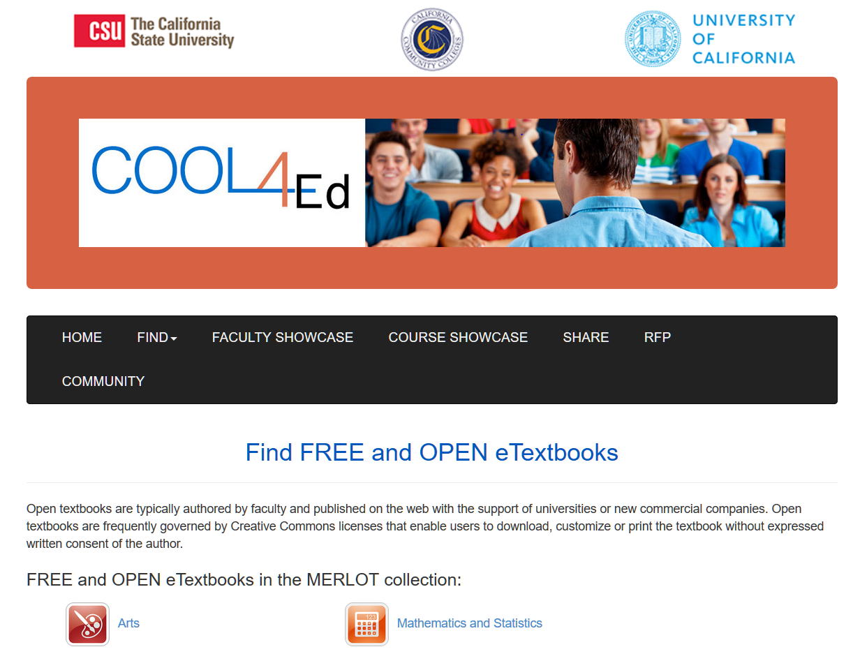

Slide 10
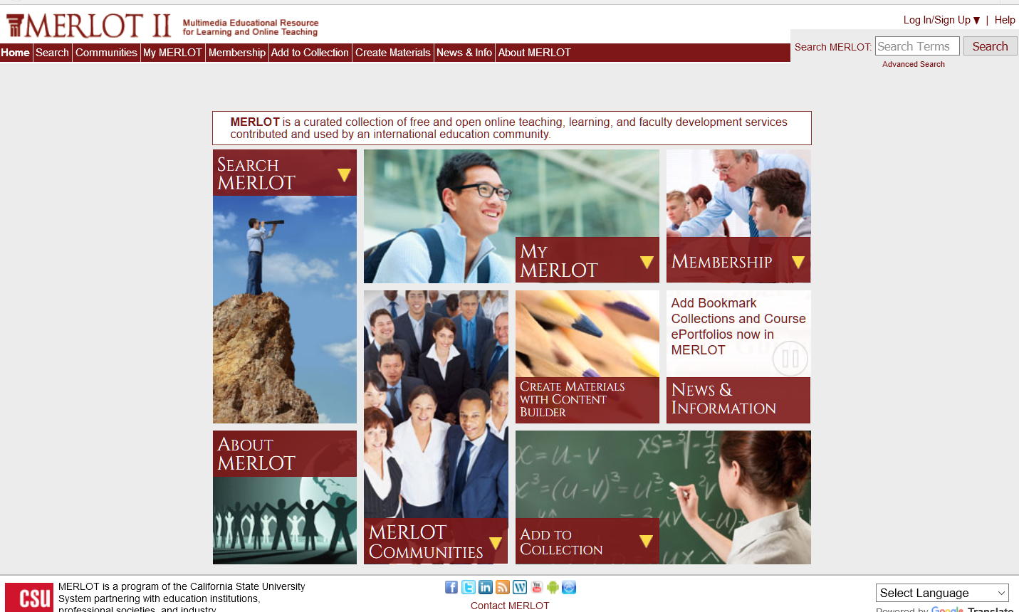

Slide 11
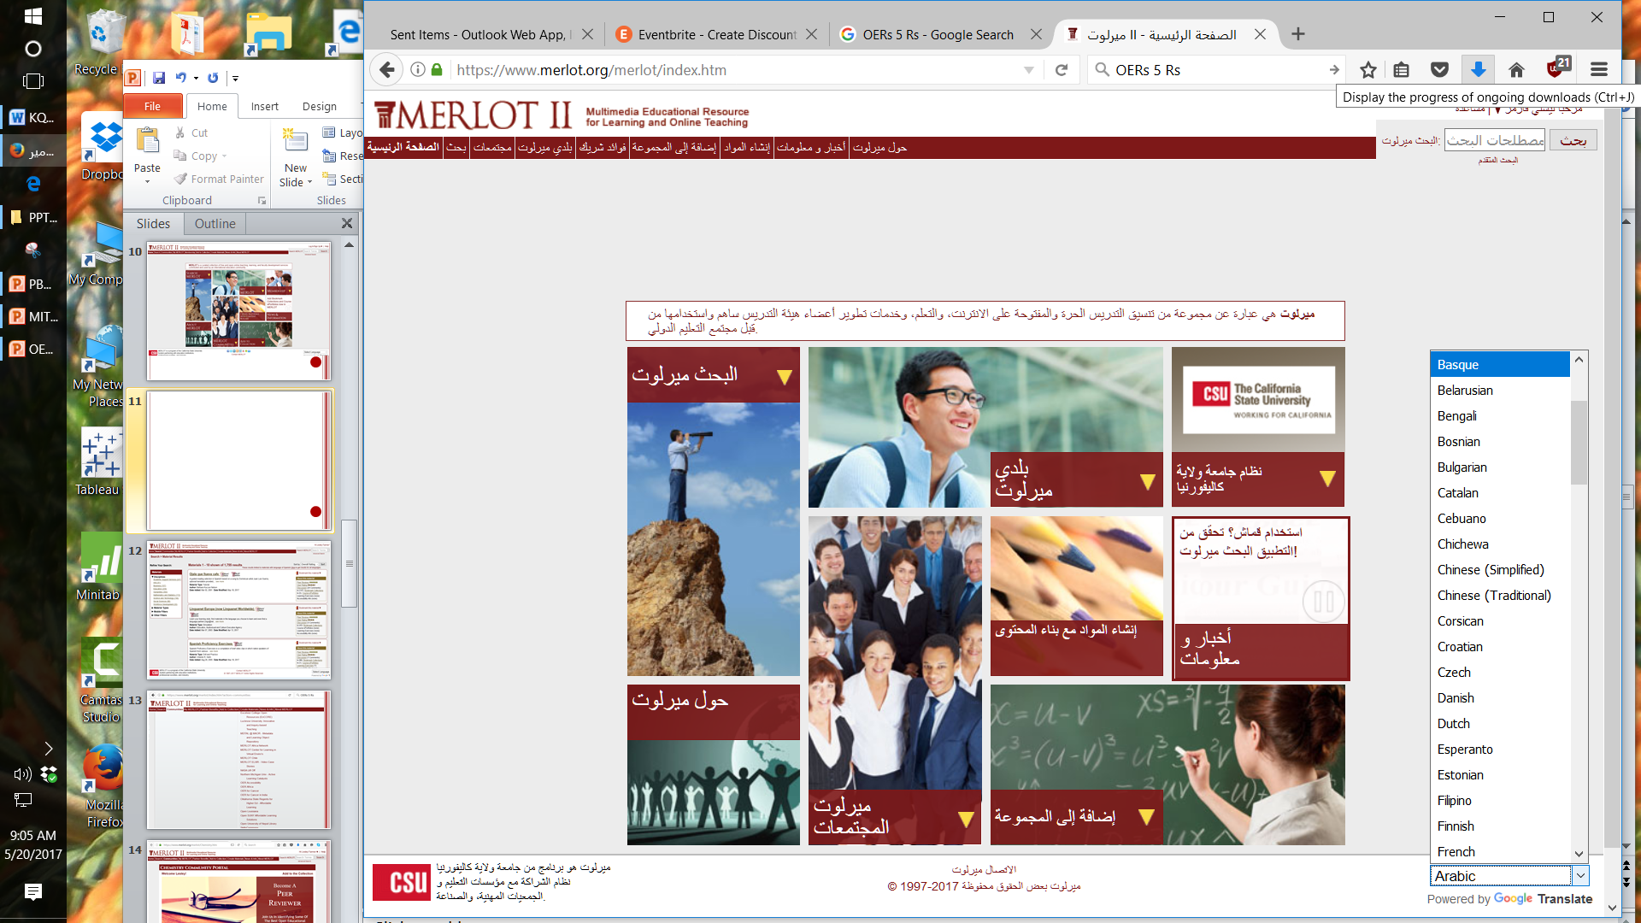

Slide 12
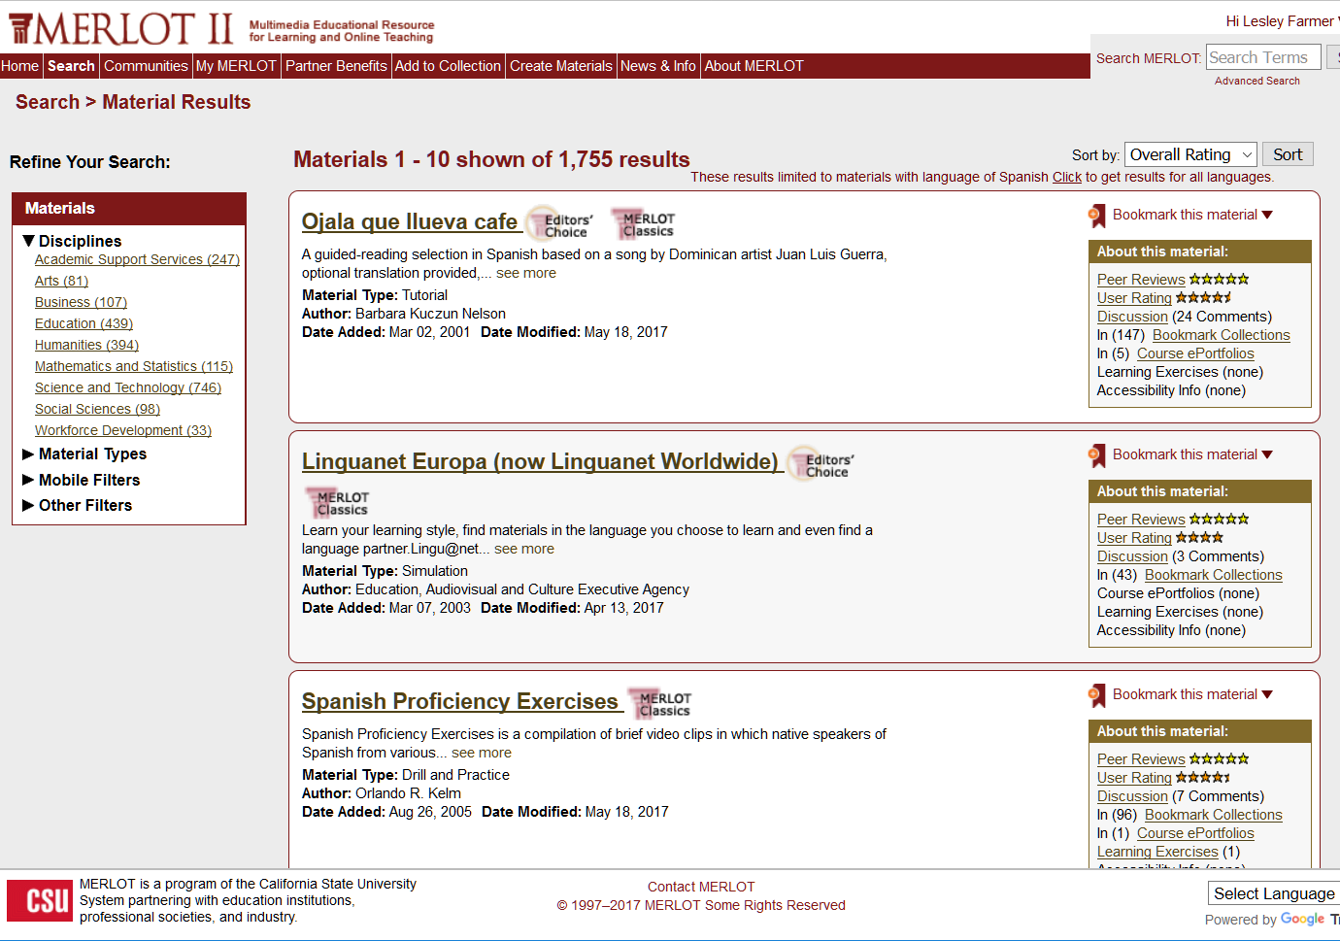

Slide 15
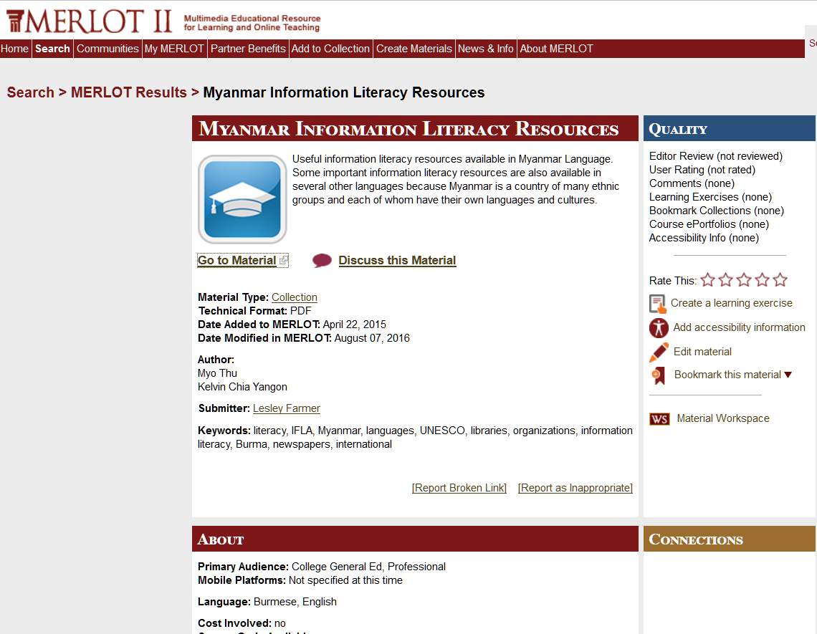

Slide 16
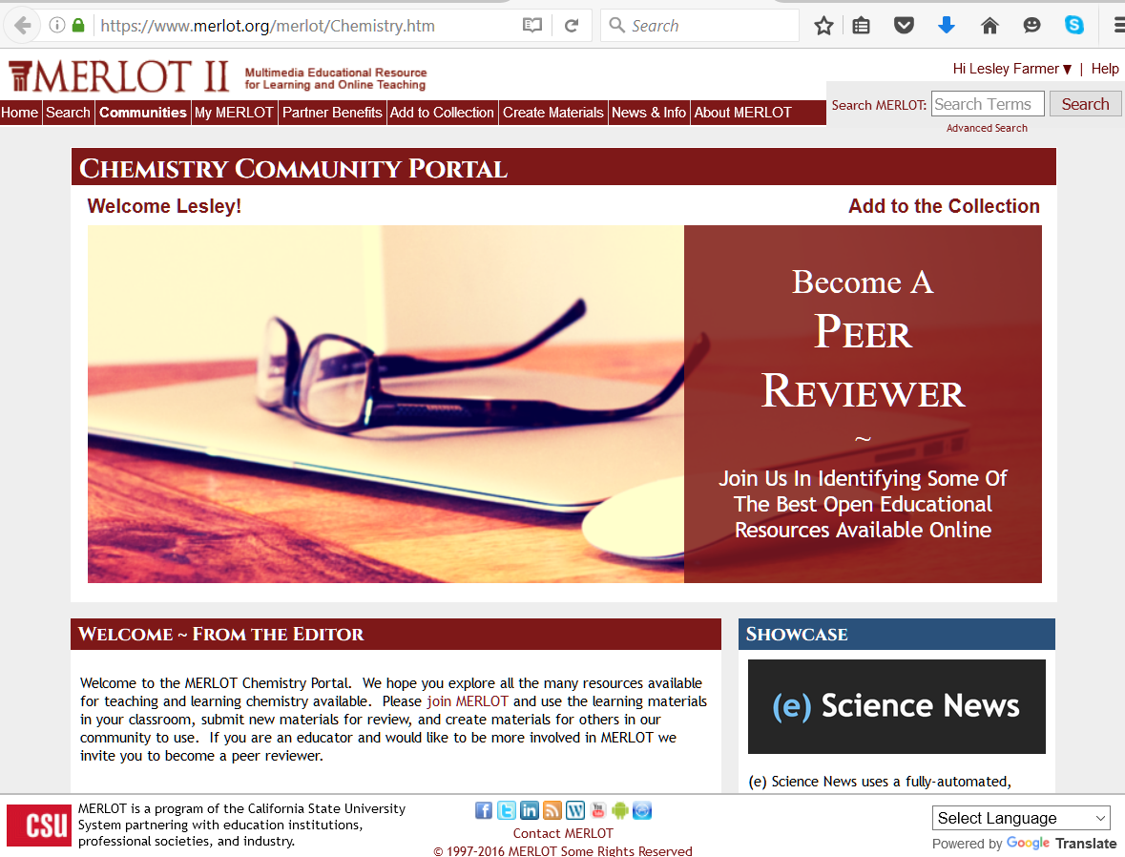

Slide 17
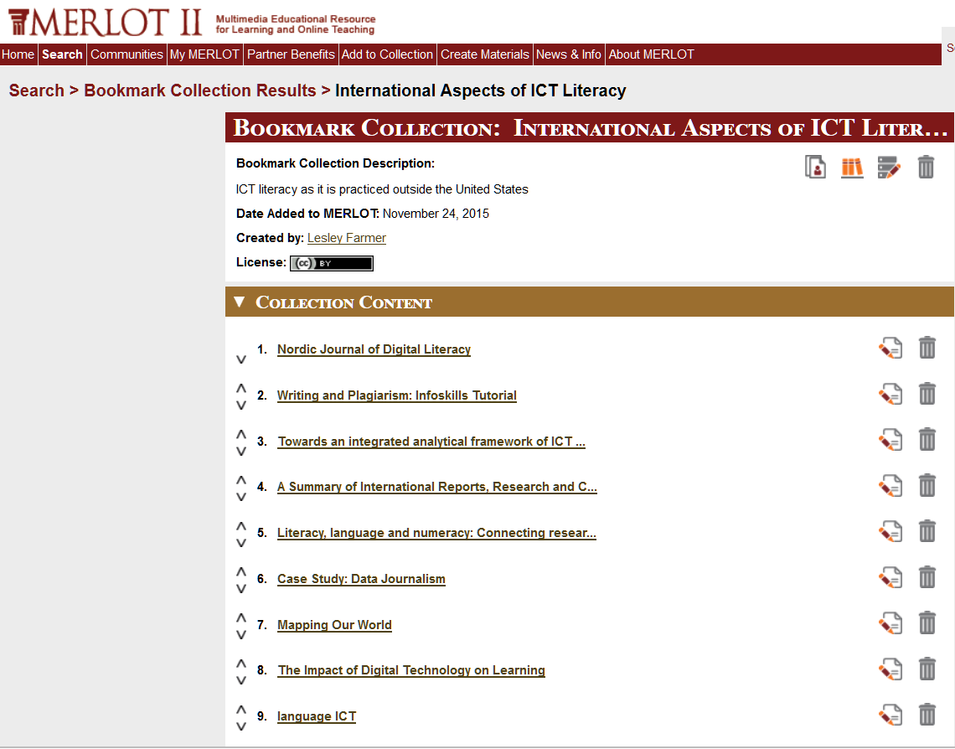

Slide 19
ICT Literacy in Physics
GENERAL:
Association of College & Research Libraries. (2006). Information literacy standards for Science/Engineering/Technology: http://www.ala.org/acrl/standards/infolitscitech
The following wiki is useful for physics information literacy: http://wikis.ala.org/acrl/index.php/Information_Literacy_in_Physics
MERLOT LINKS:
Key terms: physics, specific topics within physics, physics in related fields (e.g., geology, astronomy), materials science
Science and Technology/ Physics
Academic Support Services/ ICT literacy
Academic Support Services/Library and Information Services
https://www.merlot.org/merlot/Physics.htm
LIBGUIDES:
http://guides.library.georgetown.edu/physics Georgetown University guide to physics resources, including background information, articles and databases, data sets and statistics, physical properties and spectra, websites, and citation help
http://libguides.lincolnu.edu/content.php?pid=417184 Lincoln University guide to physics research, including how to locate, read and cite scientific articles; how to create a literature review; how to give scientific presentations

Slide 20
ARTICLES:
Achuthan, K., Bose, L. S., Francis, S., Sreelatha, K. S., Sreekala, C. O., Nedungadi, P., & Raman, R. (2014, May). Improving perception of invisible phenomena in undergraduate physics education using ICT. In Information and Communication Technology (ICoICT), 2014 2nd International Conference on (pp. 226-231). IEEE. https://www.researchgate.net
Chandra, V., & Watters, J. J. (2012). Re-thinking physics teaching with web-based learning. Computers & Education, 58(1), 631-640. http://eprints.qut.edu.au/48835/
LEARNING ACTIVITIES IDEA STARTERS:
Ask students to create a timeline of technical advances in physics.
Ask students to create a timeline about a physics controversy (e.g., big bang theory, nature of gravity).
Ask students to research ethical issues relative to physics.
Ask students to locate and summarize legislation and regulations that impact physics (e.g., OSHA, accessibility, intellectual property). Then ask them whether this is the way the law ought to be or whether it should be changed and why.
Ask students to create an infographic to help communicate a physics concept or issue.
Ask students to create a timeline of physics advances.
Ask students to flowchart a physics experiment.
Ask students to take photos of a physics concept, and annotate them in terms of locale, evidence of the concept, and implications (see http://www.physicsclassroom.com/The-Photo-Gallery).
Ask students to locate and analyze photos where the image contradicts or defies physical principles (e.g., http://pgwar.com/), and explain what principles are involved.

Slide 21
Ways to Use OERs
Instructional aid
Introduction to concepts
Discussion starters (e.g., case studies, articles, videos)
Required or optional reading to deepen understanding
Activity (e.g., simulations, drill and practice, research, production)
Assessment
Explore http://learning.nd.edu/remix/projects/index.html

Slide 22
Matching Objectives and Media
What should be accomplished? What is the objective?
What relevant, high-quality resources are available -- and accessible?
What is needed to learn to use the resource?
Should I incorporate that resource into the lesson?
How will I incorporate that resource?
Explore http://www.crlt.umich.edu/tech_tools_table

Slide 23
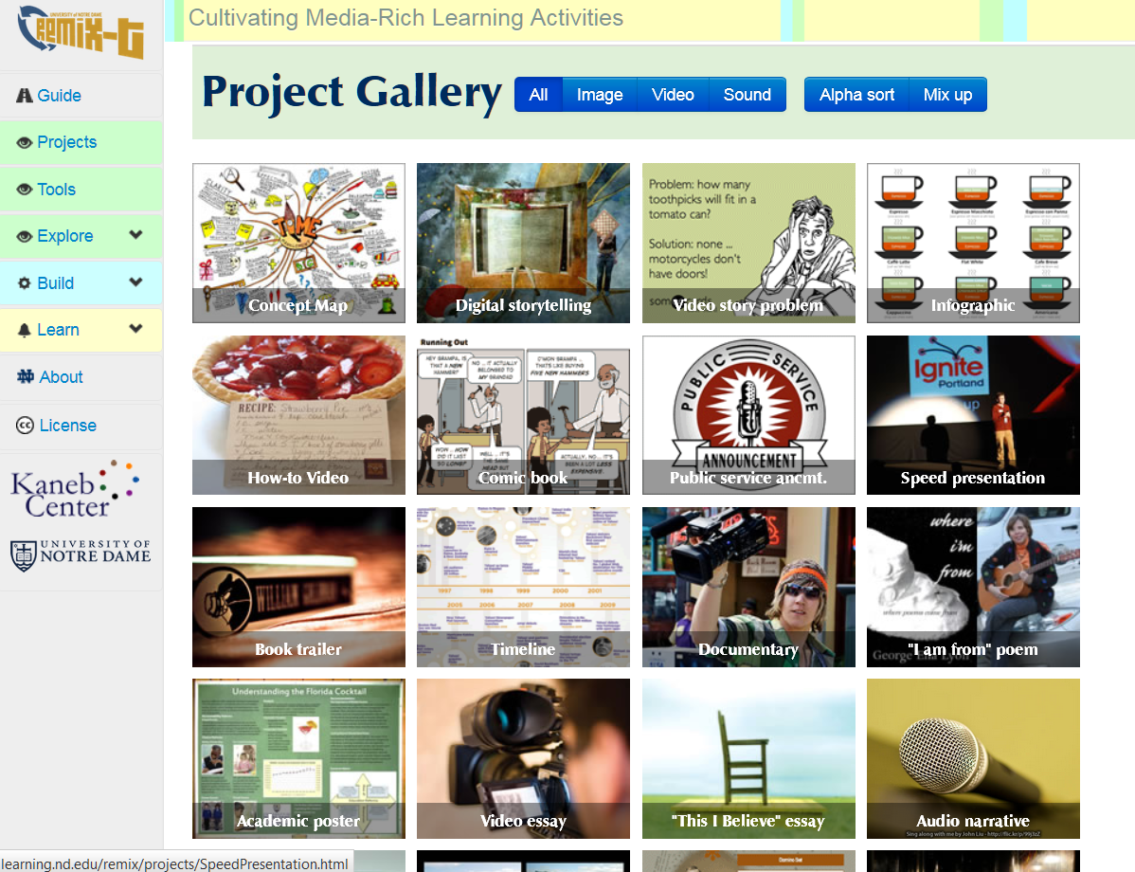

Slide 24
Learning Activities
Environment: visual inventory, field trips, animal rights
Insects: compare insect populations with epals, make graphs of insect populations
Sports: measure student ability, videotape and analyze performance, research math in sports
Health: ads, fotonovelas, tech healthcare, assistive tech
NASA-based: flight research and simulation, space exploration, earthquake study, women in science
Career exploration: shadowing, service learning, role of tech in careers, online volunteering
YOUR IDEAS??

Slide 26
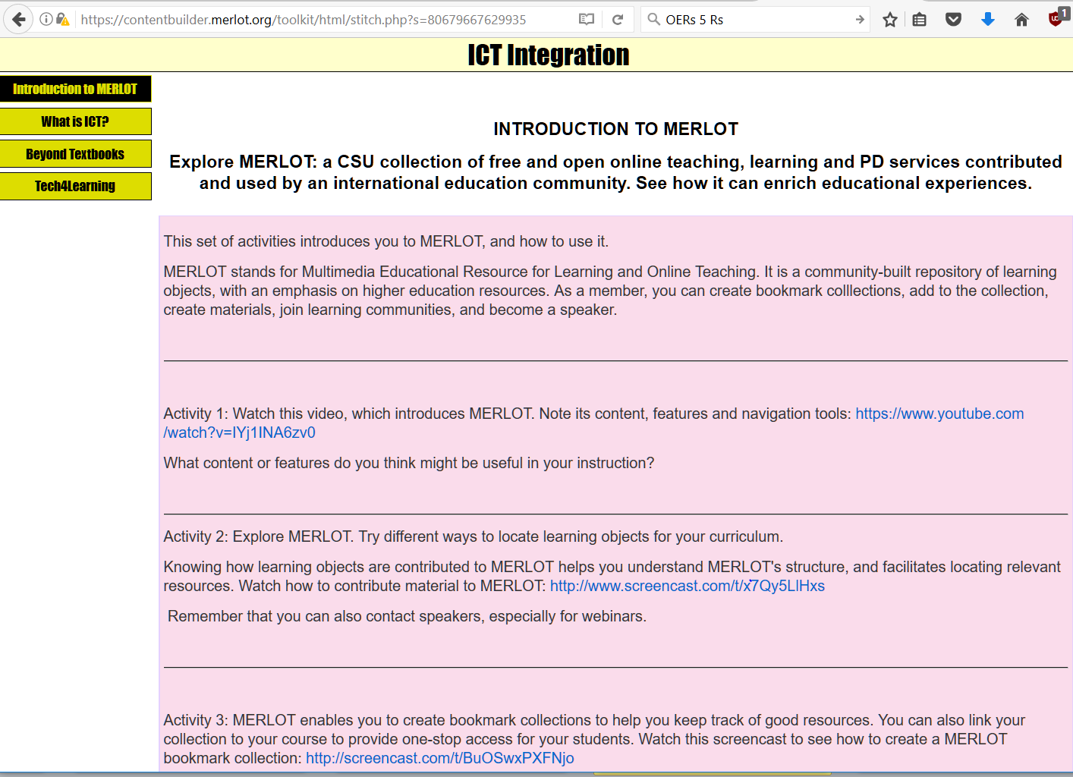

Slide 27
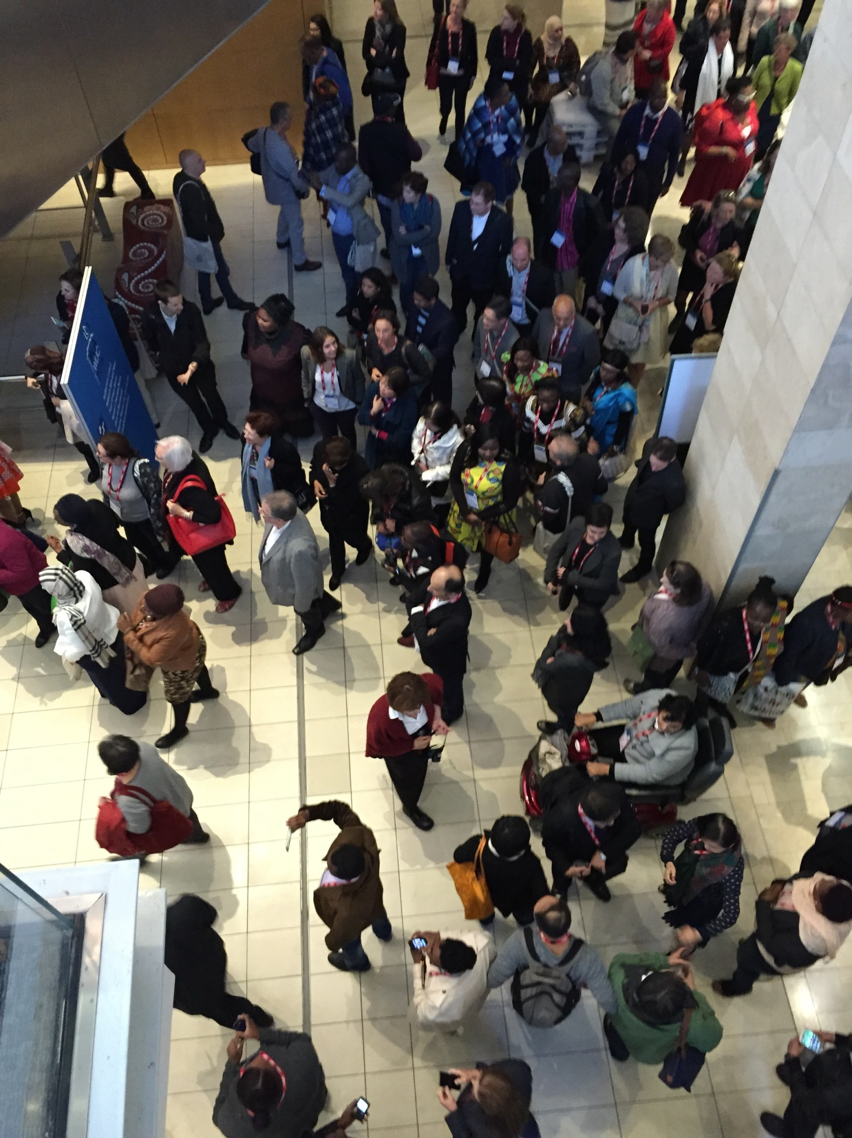
Omni-World Educational Reach!

